Slide 1
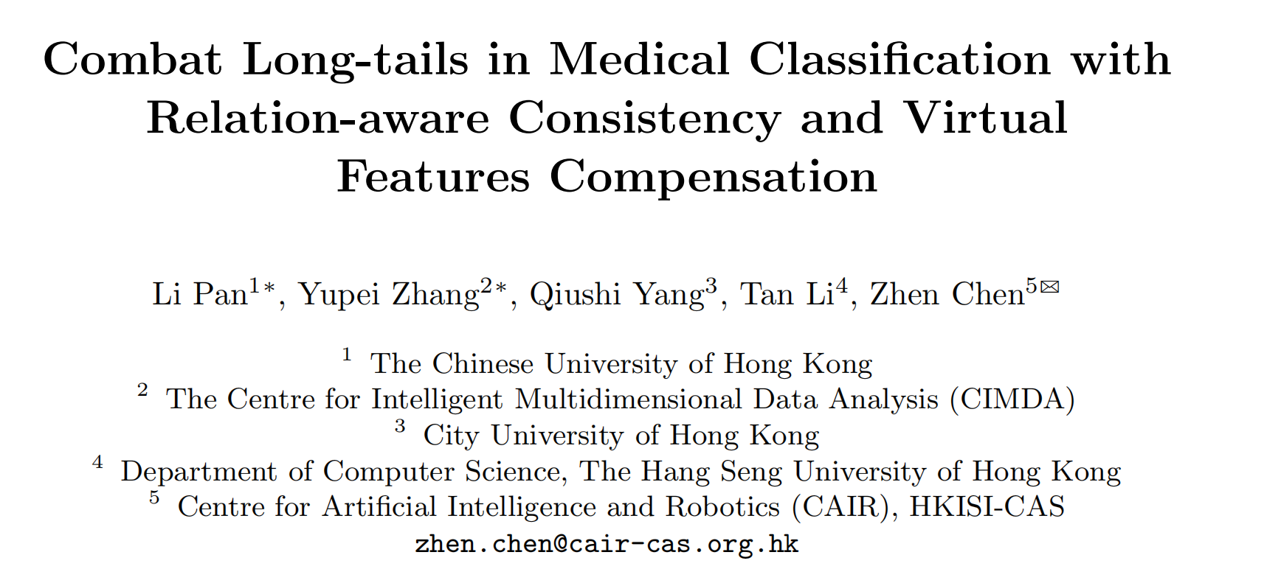

Slide 2
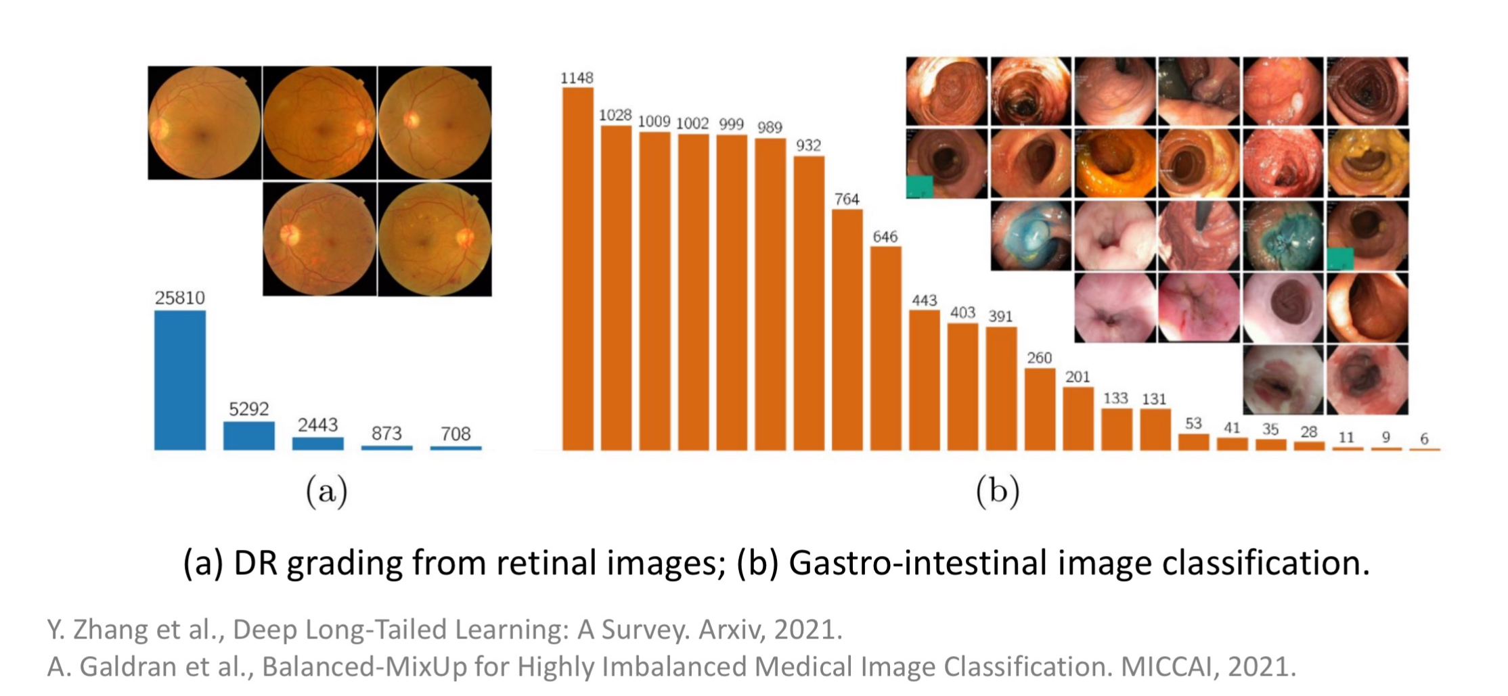
Background
Scarcity of diseased samples —> inherent imbalance datasets —>degrade diagnostic performance

Slide 3
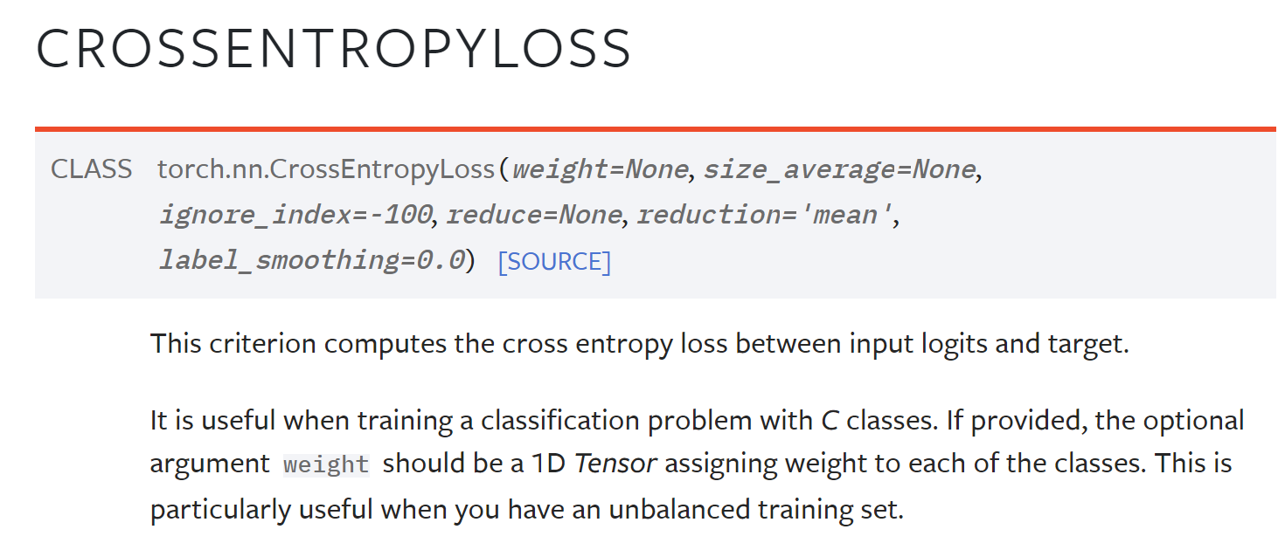
Current Approach:
1. Re-weighting the contribution of different class
2. Rebalance the data distribution (under-sample the head classes, over-sample the tail classes)
3. Two-Stage method: train the model on the entire dataset —> fine-tune the classifier using rebalancing techniques

Slide 4
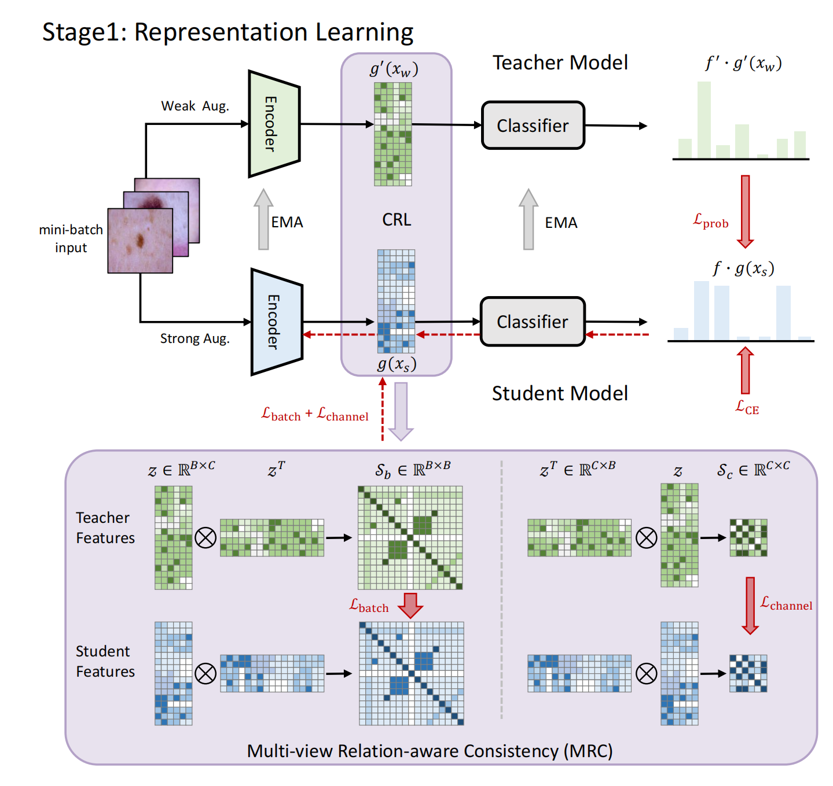

Slide 5
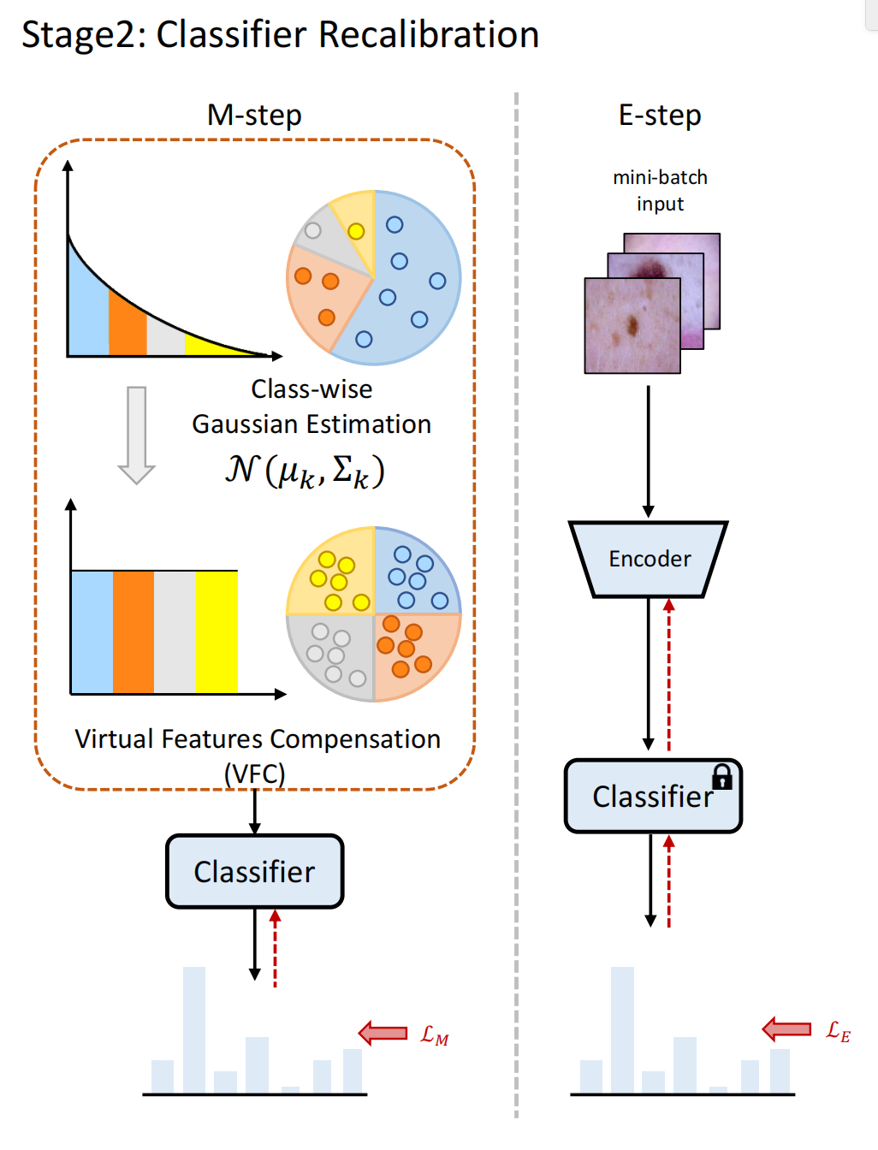

Slide 6
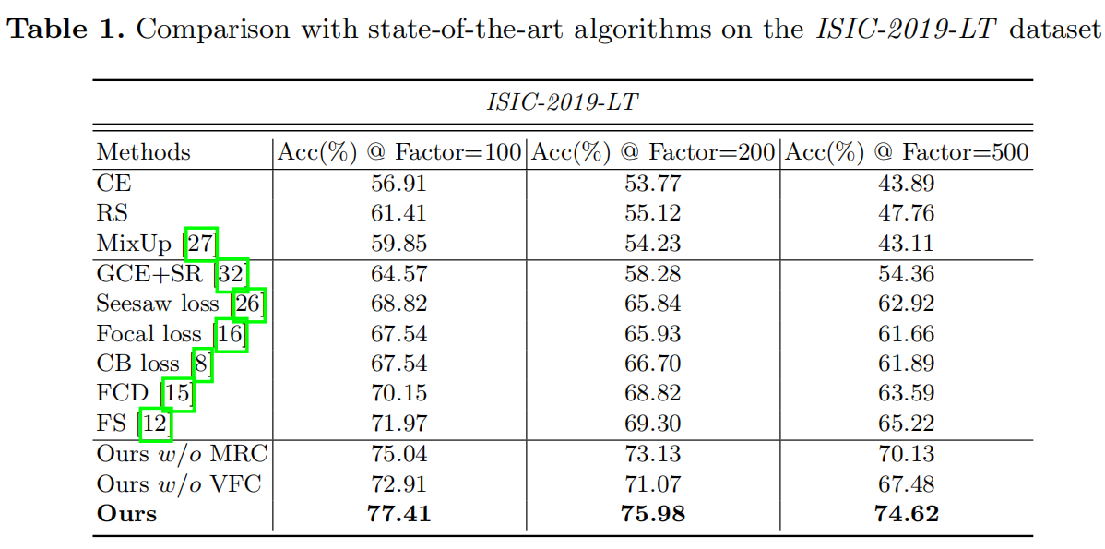
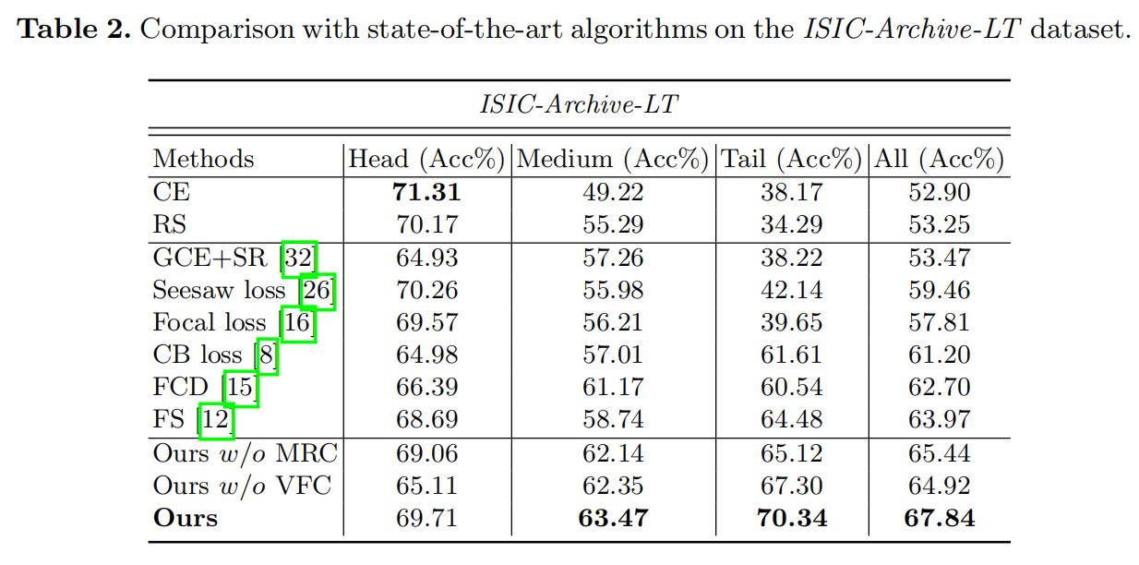

Slide 7
